Slide 1


.CSV Data Analysis Using PyTorch M. Eric Carr, MSCpE (Drexel Engineering Technology)
GitHub: github.com/FlyByPC/PyTorchCSV
Use PyTorch to classify your own numeric data. On your smartphone, if need be.

Slide 2
Audience
STEM professionals (and amateurs, too!) not already familiar with PyTorch etc.
Machine Learning is just getting started, and is already a very powerful tool.
Anyone with numeric data in .csv files that they would like to classify
Anyone interested in how feedforward neural networks work, at a high level
EET 325 students interested in the extra credit assignment

Slide 3


So, what is PyTorch?
PyTorch is a machine learning library for Python, based on the Torch library.
Python itself is a high-level programming language. It is popular for Machine Learning tasks (because of libraries like PyTorch).
Both Python and PyTorch are available for free. (Both are open source.)
We will be using "feedforward neural networks," which are one form of Machine Learning, which is one form of what is called Artificial Intelligence.

Slide 4
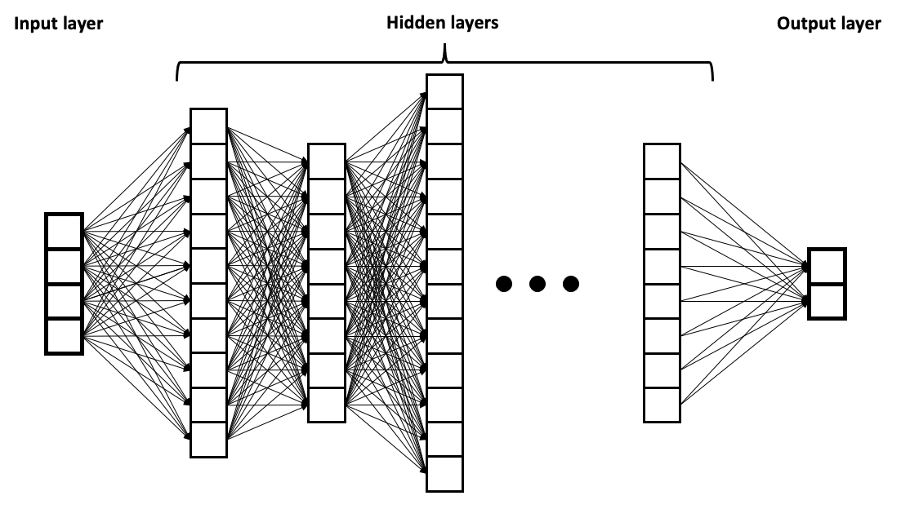
Neural Networks (feedforward type)
Image: https://upload.wikimedia.org/wikipedia/commons/2/2f/Example_of_a_deep_neural_network.png
Neural networks take numeric input from input layer "neurons"
These signals, multiplied by learned weights, activate the 1st-layer neurons
The 1st-layer neurons, multiplied by learned weights, activate the 2nd layer.
The last-layer neurons' signals similarly affect the output-layer neuron(s).

Slide 5
Neural Networks (feedforward type)
So, data is fed in to the input layer (data is encoded as neuron inputs)
Each hidden layer can learn to detect patterns in the previous layer
As the signals flow through the network, more complex patterns can be made.
Eventually, the network can learn quite complex relationships in the data. (These networks are especially good at analyzing high-dimensional data.)

Slide 6
Neural Networks (training)
To classify input data, the network must learn the patterns in the data. (I.E. the network weights and biases must be updated.)
This can be done by "supervised learning" – I.E. training on a known dataset. Already-labeled data is fed into the system, and a prediction is made.
These predictions are terrible (random) at first, but the data can be used to update the network weights, allowing the network to learn.
Fortunately, all of this is done (mostly) automatically, by PyTorch.

Slide 7
Our process
Ingredients:
Training data (.csv file with numeric features columns and one or more numeric label columns)
Data may need to be preprocessed (to be discussed)
Inference data (.csv file with features columns but no labels, that you want to label.)
If any training columns needed to be preprocessed, these will, too.
Python 3.x and the PyTorch library
www.python.org ; PyTorch can be installed by Python's package manager ("pip")
A script (Github link provided in resources slide at the end of this presentation)
(Optional) A GPU can help get the results faster (in some cases)
Process:
Decide on a network topology and other hyperparameters (to be discussed);
Train the network on your training data (feedback on training fit is provided)
Run the network in inference mode on your inference data, to label it
…Profit?

Slide 8
Example: .csv training data
We will assume that we have (hopefully, lots of) data, as follows:
.csv file format (others can be readily converted);
N columns of "features" (input data parameters)
One or more "label" columns (output data parameters)
This column is present for training data; for inference, the network will predict the label.
distance_from_home | distance_from_last | relative_expense | repeat_retailer | used_chip | used_PIN | online_order | fraud
57.87785658 | 0.311140008 | 1.945939978 | 1 | 1 | 0 | 0 | 0
10.8299427 | 0.175591502 | 1.294218811 | 1 | 0 | 0 | 0 | 0
5.091079491 | 0.805152595 | 0.427714561 | 1 | 0 | 0 | 1 | 0
2.247564328 | 5.600043547 | 0.362662578 | 1 | 1 | 0 | 1 | 0
44.190936 | 0.566486268 | 2.222767298 | 1 | 1 | 0 | 1 | 0
5.586407674 | 13.26107327 | 0.064768465 | 1 | 0 | 0 | 0 | 0
3.724019125 | 0.956837928 | 0.278464945 | 1 | 0 | 0 | 1 | 0
4.848246572 | 0.320735427 | 1.273049524 | 1 | 0 | 1 | 0 | 0
0.876632256 | 2.503608927 | 1.516999315 | 0 | 0 | 0 | 0 | 0
2.131955666 | 56.37240054 | 6.358667322 | 1 | 0 | 0 | 1 | 1
Data retrieved from Kaggle: https://www.kaggle.com/datasets/dhanushnarayananr/credit-card-fraud

Slide 9
Example: .csv inference data (from Excel or similar)
Now that the network is trained, we can feed in new data that doesn't have labels
.csv file format (others can be readily converted);
N columns of "features" (input data parameters). No output ("label") parameter.
The script will run this data through the network and produce a new, labeled copy.
distance_from_home | distance_from_last | relative_expense | repeat_retailer | used_chip | used_PIN | online_order
2.961669 | 0.836399 | 2.355077 | 1 | 0 | 0 | 0
19.30372 | 0.664108 | 0.673727 | 1 | 0 | 0 | 1
1.164353 | 0.484345 | 1.013047 | 0 | 0 | 0 | 1
12.71241 | 0.523582 | 0.653478 | 1 | 1 | 0 | 1
129.9482 | 15.70103 | 1.523281 | 1 | 0 | 1 | 1
5.679132 | 0.089532 | 0.666496 | 1 | 0 | 0 | 1
10.79385 | 0.306373 | 1.917387 | 1 | 0 | 0 | 0
11.41176 | 2.233248 | 1.761725 | 1 | 1 | 0 | 1
2.987854 | 9.315192 | 1.921046 | 1 | 0 | 0 | 1
0.530985 | 1.501575 | 4.421388 | 0 | 1 | 0 | 0
Data retrieved from Kaggle: https://www.kaggle.com/datasets/dhanushnarayananr/credit-card-fraud

Slide 10
Preprocessing
Before we can train a neural network on our data, it has to be in a format that the network can understand!
Neurons expect one or more inputs, each of which is a number.
Perhaps 0.0 to 1.0 inclusive, or binary 0/1, or an int or float…
Signals representing Yes/No, or a range between 0.0 and 1.0, are often best
What is difficult to represent is something like "Philadelphia" or "John Smith"
So we may need to encode our source data into a format we can train:
Features like "brand" with N options may need to be encoded as a "one-hot" array.
"Day-of-week" might be learnable as an integer, but one-hot would probably be best.
(Do this before presenting the .csv file to the script.)

Slide 11
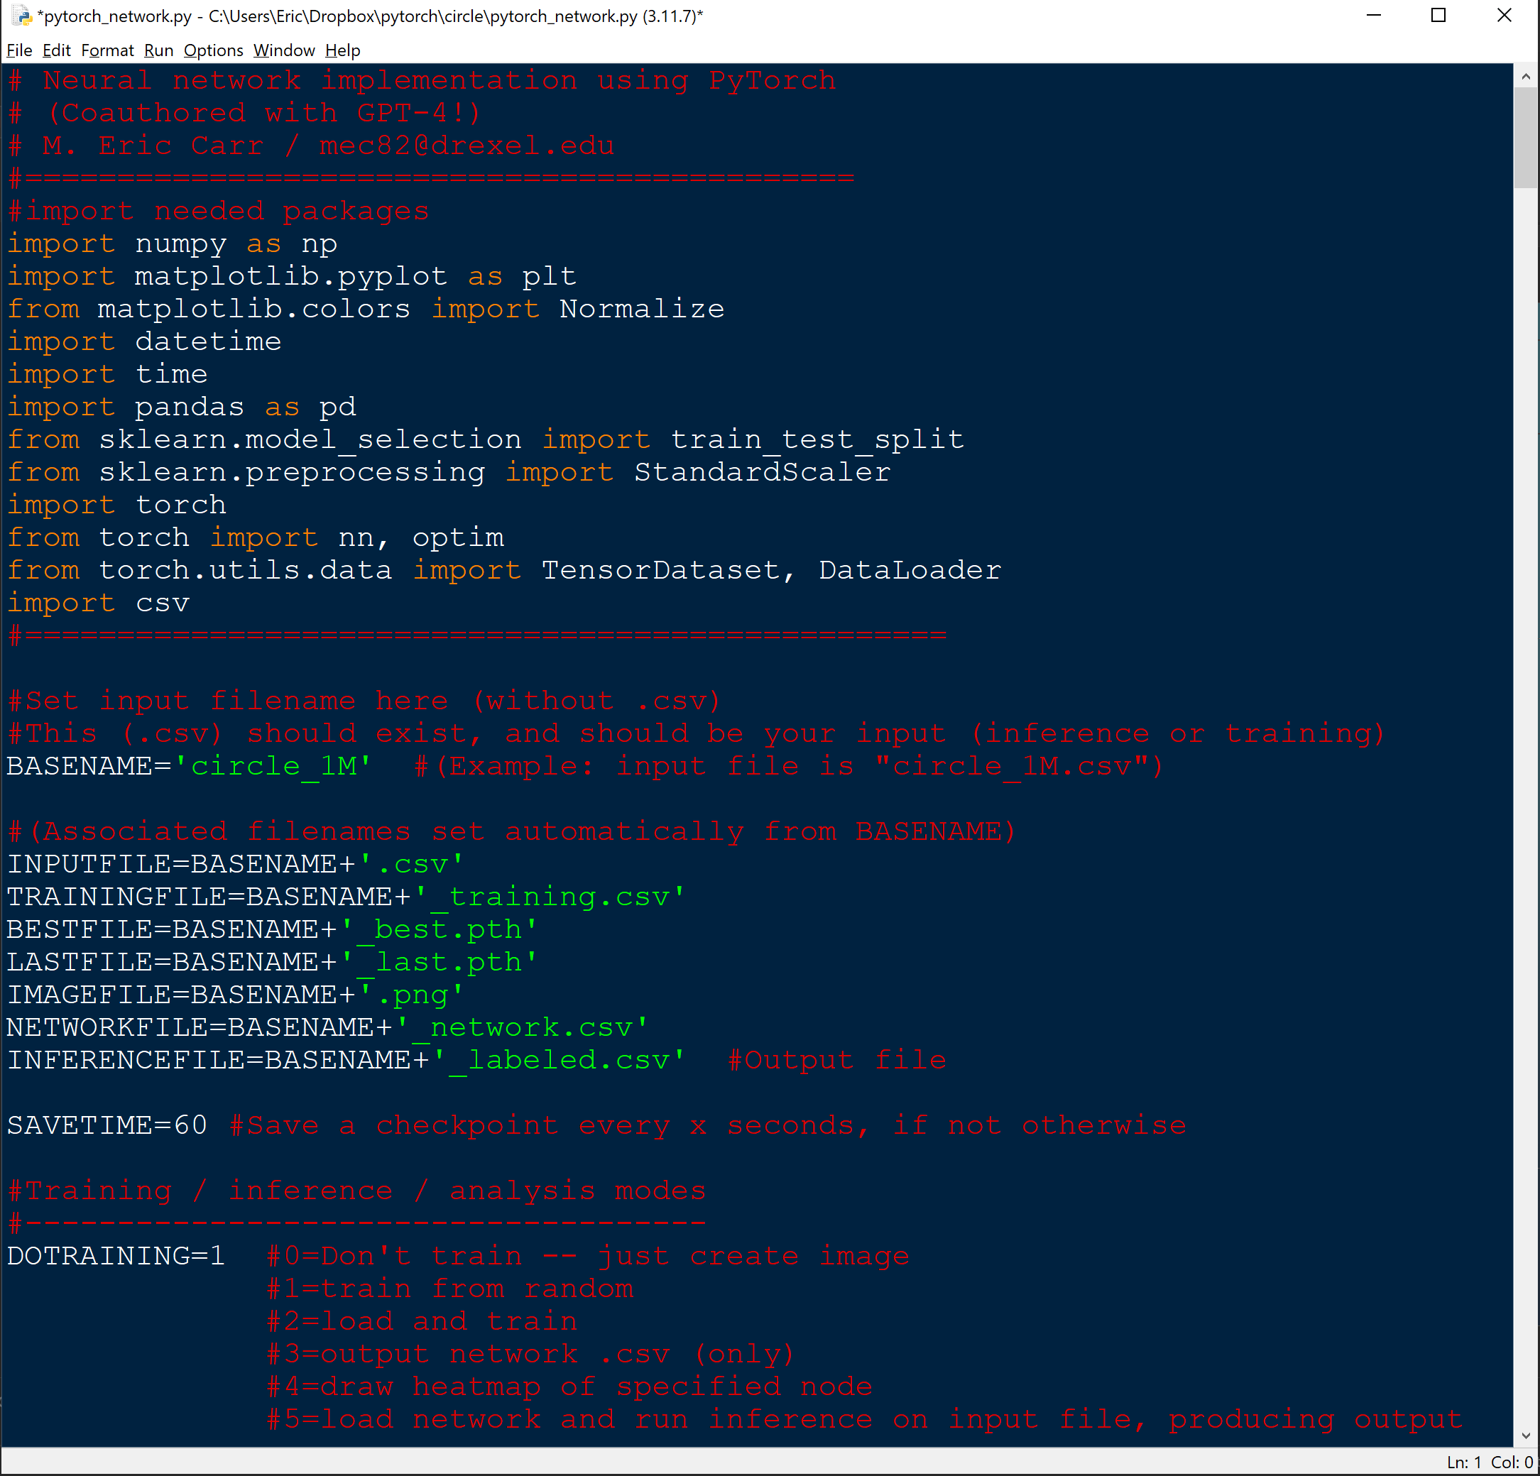
The PyTorch script
https://github.com/FlyByPC/PyTorchCSV
~700 lines of Python code
Uses several popular libraries
Written for "modify-and-run"
How to use:
Provide input file(s)
Choose a mode (to be discussed)
Set parameters (to be discussed)
Run

Slide 12
Run mode
"DOTRAINING" variable setting controls script run mode:
0: Generate an output image (or heatmap) given X/Y input
1: Train the network from scratch
2: Load and train the network
3: Output network weights to .csv
4: Draw heatmap of a node (experimental; for X/Y input data)
5: Run inference (use a trained network to label unlabeled data from a .csv file)
(Use mode 1, maybe 2, then 5.)

Slide 13
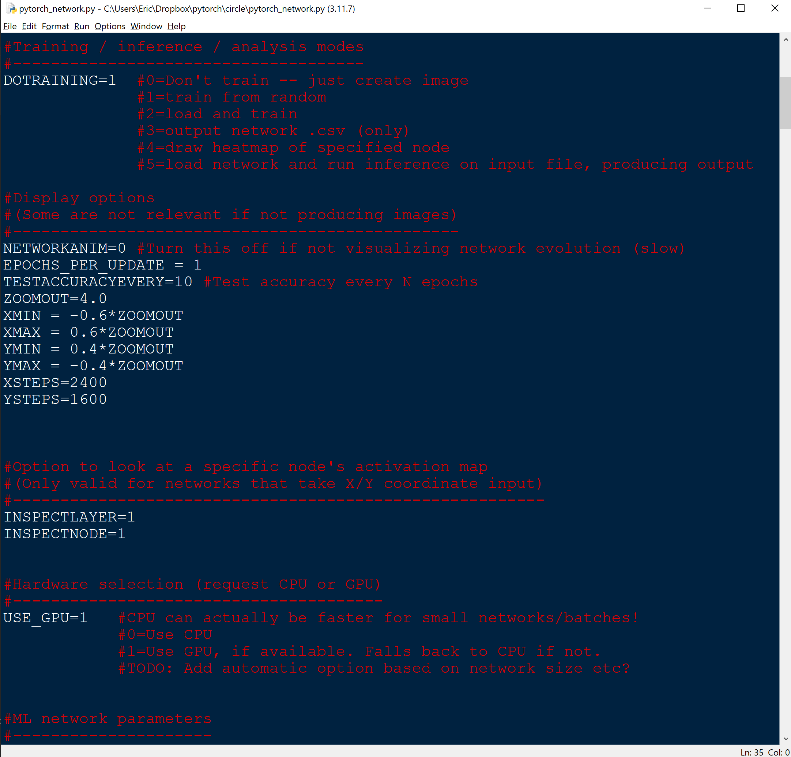
Display options
Most of these can be ignored.
They are mostly associated with generation of heatmaps for either the whole network or individual nodes.
TESTACCURACYEVERY is relevant for all training. Every N training epochs, it checks to see how the network does against the whole training dataset.
EPOCHS_PER_UPDATE can help control the amount of output

Slide 14
Inspect Layer/Node
These options select which hidden layer and which node to inspect, if using that option.
They're experimental and probably at least partially broken, but there if you want to experiment with them.
USE_GPU either allows the script to use the GPU if available, or selects CPU-only.

Slide 15
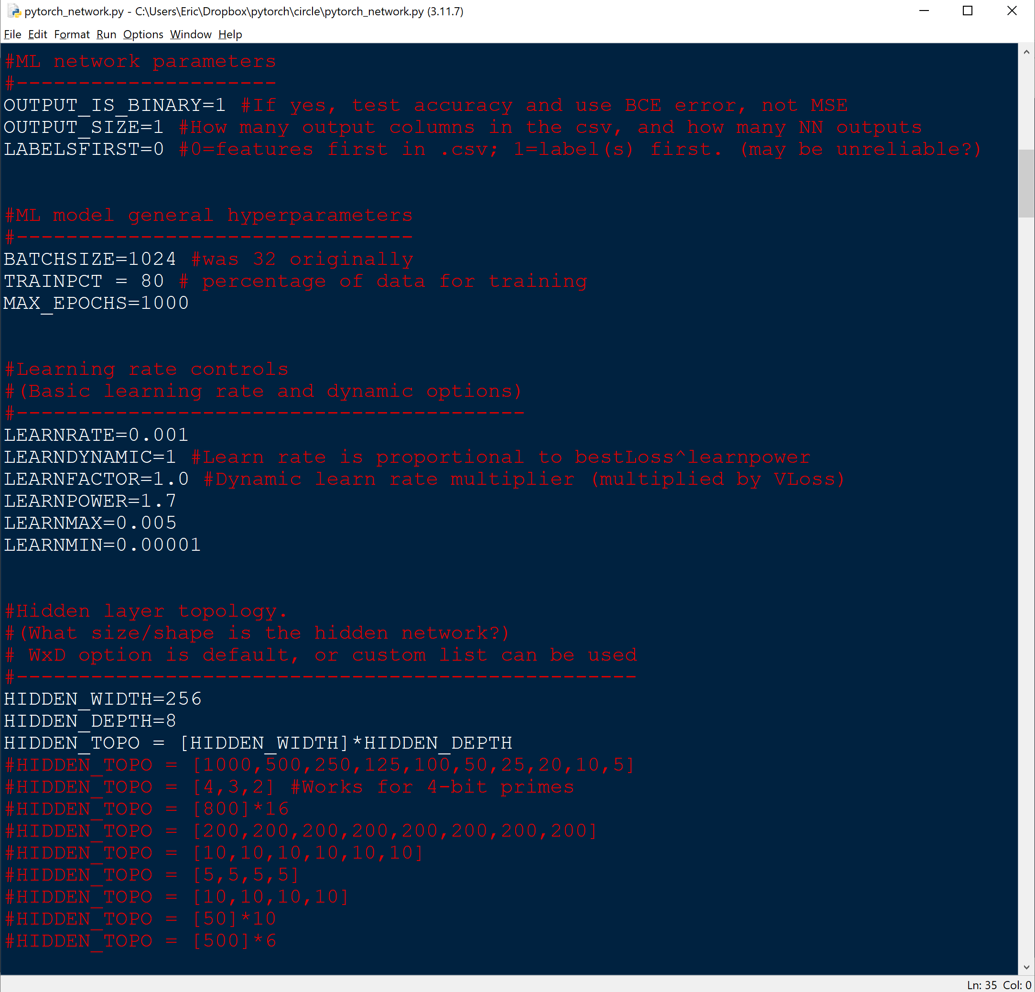
Learning/net params
ML model hyperparameters:
Batch Size trains N examples at once before choosing how to update the weights.
Larger is more efficient but less accurate (may converge slowly)
Output size: # of output neurons
Training Percent
How much of the training file to use for training vs. verification
MAX_EPOCHS
How many passes through the training dataset to do before stopping. (Can also be stopped.)

Slide 16
Learning/net params
Learn Rate
How responsive is the network to training data error? Larger rates learn faster but can overshoot, oscillate, etc.
Dynamic learning rate attempts to optimize this by tying learning rate to current verification loss. (I.E. the better the solution, the slower the learning rate, since we don't want to change much.)
Power of 1.7 was empirically determined to have optimization potential. ("It seems to work.")
…(You definitely want to have a max, and probably min, rate.)

Slide 17
Learning/net params
Network size/shape
This sets HIDDEN_TOPO, which is a list describing the topology of the hidden layers.
The default option is for a "rectangular" network of HIDDEN_WIDTH by HIDDEN_DEPTH.
Some other rectangular and nonrectangular examples are provided.
Remember, for each layer:
Each neuron has to process input from each neuron in the last layer!

Slide 18
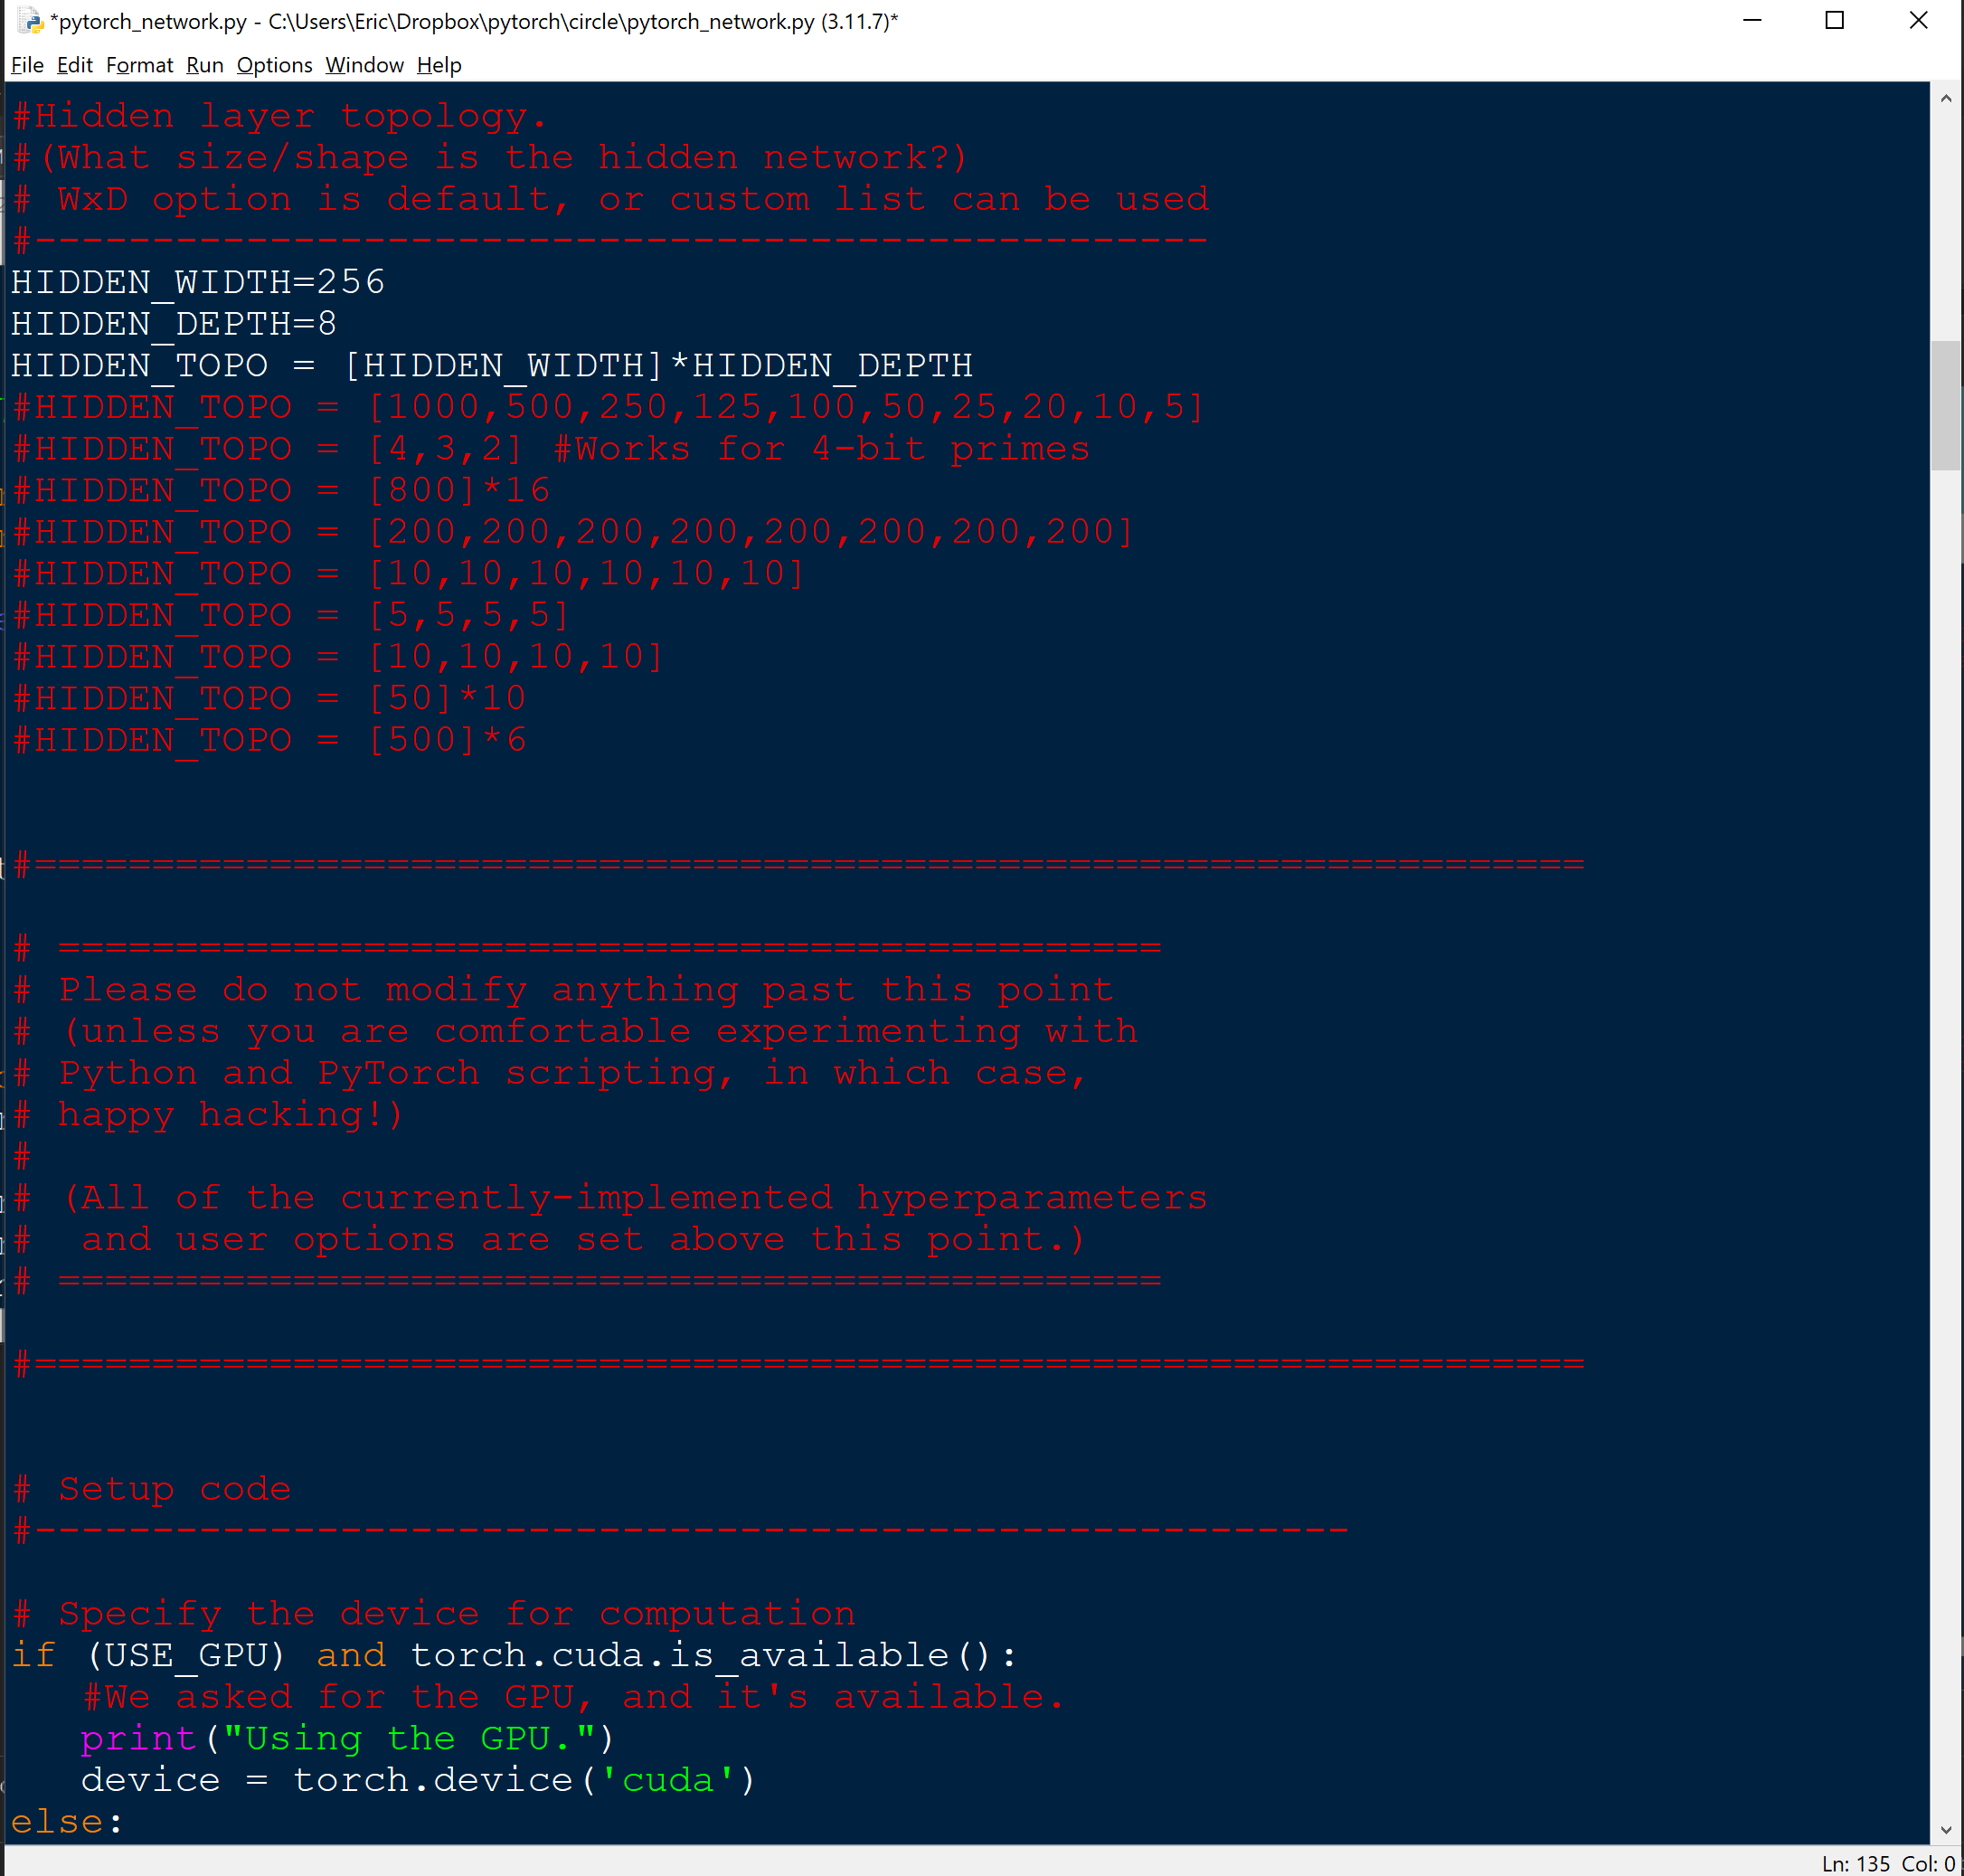
The rest…?
Everything below the hidden-layer topology section is the body of the script.
It's intended to be used by just tweaking the options.
If you want to experiment, though, dive in!
…and if you come up with a good GUI, send me a pull request!

Slide 19



(Demonstration – "circle" data)
If your input data has two continuous variables (I.E. can be thought of as "X" and "Y" axes), you can visualize the heatmap of outputs for one neuron or the whole network, mapped to X/Y.
Included in the repository are three images, showing tiny, small, and medium networks, trained on a "circle" dataset (x, y, and {0,1} if in the circle or not.)
A FreeBasic script is provided, to generate "circle" training/inference data.

Slide 20
(Demonstration – credit card fraud data)
Kaggle.com provides access to hundreds of high-quality datasets that can be used for training feedforward neural networks.
The data in the spreadsheet excepts in the first few slides is from a credit-card-fraud dataset: https://www.kaggle.com/datasets/dhanushnarayananr/credit-card-fraud
Let's try running the script to train a network on the data…

Slide 21
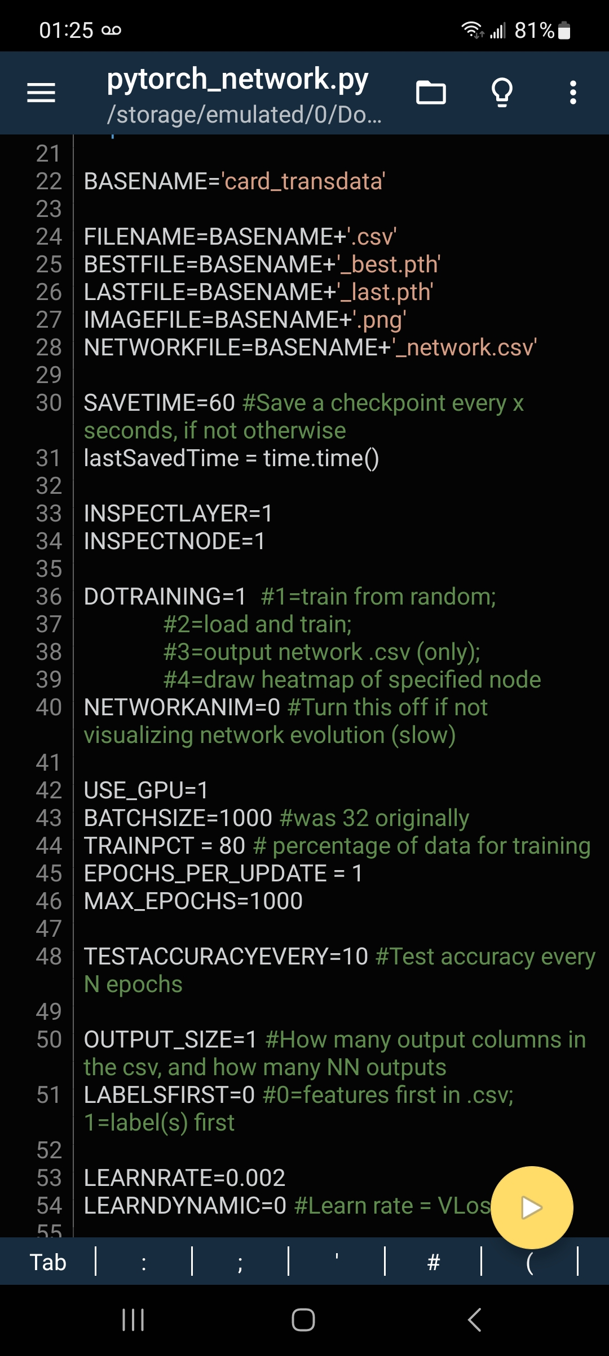
PyTorch to go: Running all this on PyDroid!
Smartphones can also run Python (and PyTorch).
You don't have access to GPU acceleration, but that's about the only difference.
Not only inference, but training, can be done locally on a mobile CPU.
Small pretrained networks are even feasible in scope to be run on microcontrollers such as ESP32 etc.
(No doubt there's an Apple solution to run Python, too. GPT4 suggests "Pythonista".)

Slide 22
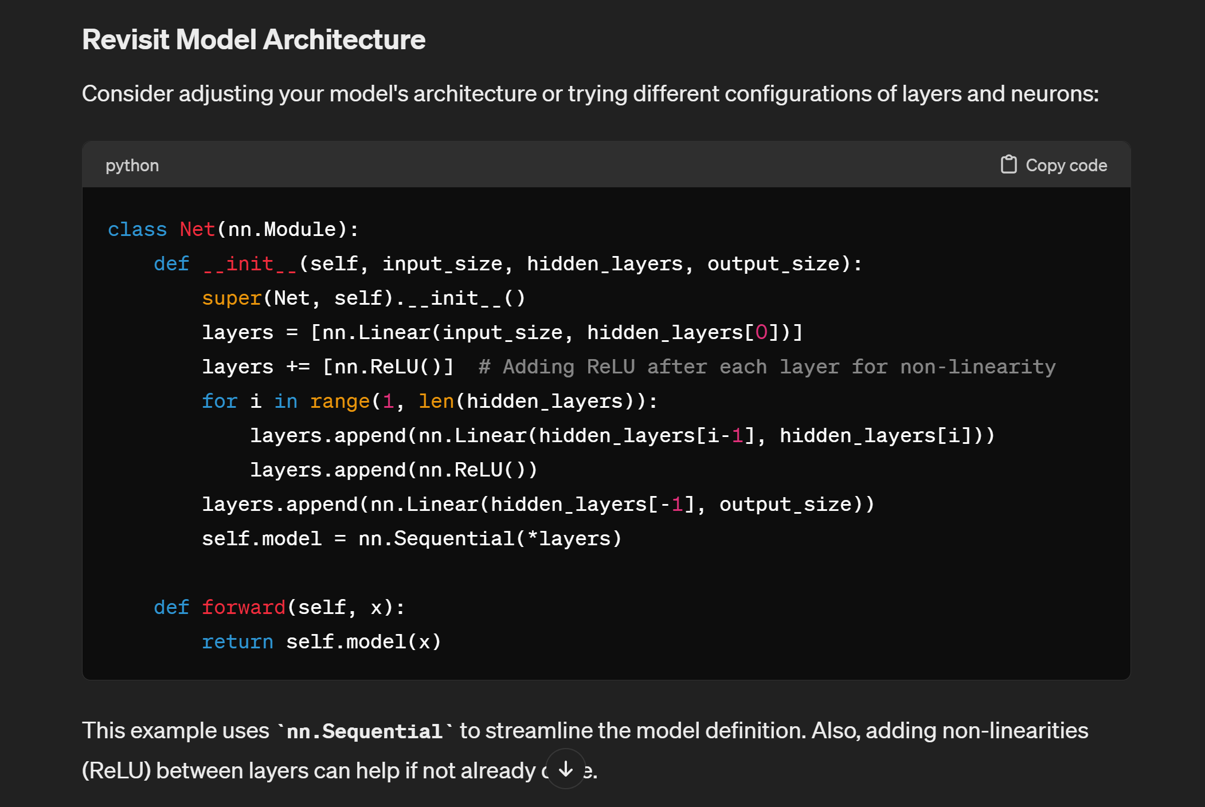
Cheat Mode: Getting GPT4 to write all this!
I didn't write most of this code! GPT-4 did, at my prompting: "Please teach me how to create feedforward neural networks using PyTorch."
(demo)

Slide 23
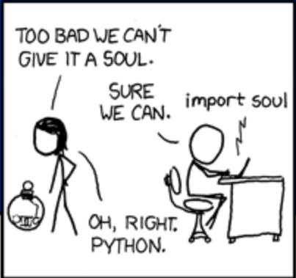
This is just the beginning…
https://xkcd.com/413/
Python, PyTorch, and friends are capable of amazing things!
PyTorch Audio – process audio, recognize and duplicate voices, etc.
Computer Vision – recognize objects, take actions, etc.
Language models
…ask your friendly local LLM to help get you started!

Slide 24
Questions?
https://github.com/FlyByPC/PyTorchCSV mec82@drexel.edu
EET 325 students: Use the provided script to analyze a data set. Choose an appropriate neural network size, and see how well you can get your network to learn the data. Write a report on your results (including varying at least two hyperparameters) for extra credit, or compare CPU vs. GPU performance varying just one. (If you pick the CPU/GPU option, compare performance on something where the difference will matter, such as batch size or hidden network size, not learning rate etc.)

